Slide 1
Operating Systems: Virtualization
CSC504
LECTURE NOTE SERIES 9
DR. OLADEJI F.A. (Lecturer)
OLATUNJI MICHAEL(Practical Anchor)

Slide 2
COURSE OUTLINE
What a virtual machine is
Components of a virtual machine
Why to use virtual machines
Files that make up a virtual machine
VMware Tools
Creating a Virtual Machine Using the Wizard

Slide 3
Virtual Machine Concepts
Ever since VMware was founded in 1998, it has been creating stable x86 virtualization platforms that allow multiple guest operating systems and applications to run on a single physical server. Before an administrator can begin creating and configuring vSphere virtual machines, it is important to understand what a virtual machine is and the concepts behind virtualizing hardware.

Slide 4
Virtual Machine Concepts Cont’d
The multiple instances of Windows or Linux systems that are running on an ESXi host are commonly referred to as a virtual machine (VM). Any reference to a guest operating system (OS) is an instance of Linux, Windows, or any other supported operating system that is installed on the VM.

Slide 5
Virtual Machine Concepts Cont’d
At the heart of virtualization lies the virtual machine.
A virtual machine is a set of virtual hardware whose characteristics are determined by a set of files; it is this virtual hardware that a guest operating system is installed on.
A virtual machine runs an operating system and a set of applications just like a physical server.
A virtual machine comprises a set of configuration files and is backed by the physical resources of an ESXi host.
An ESXi host is the physical server that has the VMware hypervisor, known as ESXi, installed.
Each virtual machine is equipped with virtual hardware and devices that provide the same functionality as having physical hardware.

Slide 6
Virtual Machine Concepts Cont’d
Each virtual machine is granted a portion of the physical hardware. All VMs have their own virtual hardware (there are important ones to note, called the primary 4: CPU, memory, disk, and network). Each of these VMs is isolated from the other and each interacts with the underlying hardware through a thin software layer known as the hypervisor. This is different from a physical architecture in which the installed operating system interacts with installed hardware directly.

Slide 7
Virtual Machine Concepts Cont’d
With virtualization, there are many benefits, in relation to portability, security, and manageability that aren't available in an environment that uses a traditional physical infrastructure. However, once provisioned, virtual machines use many of the same principles that are applied to physical servers.

Slide 8
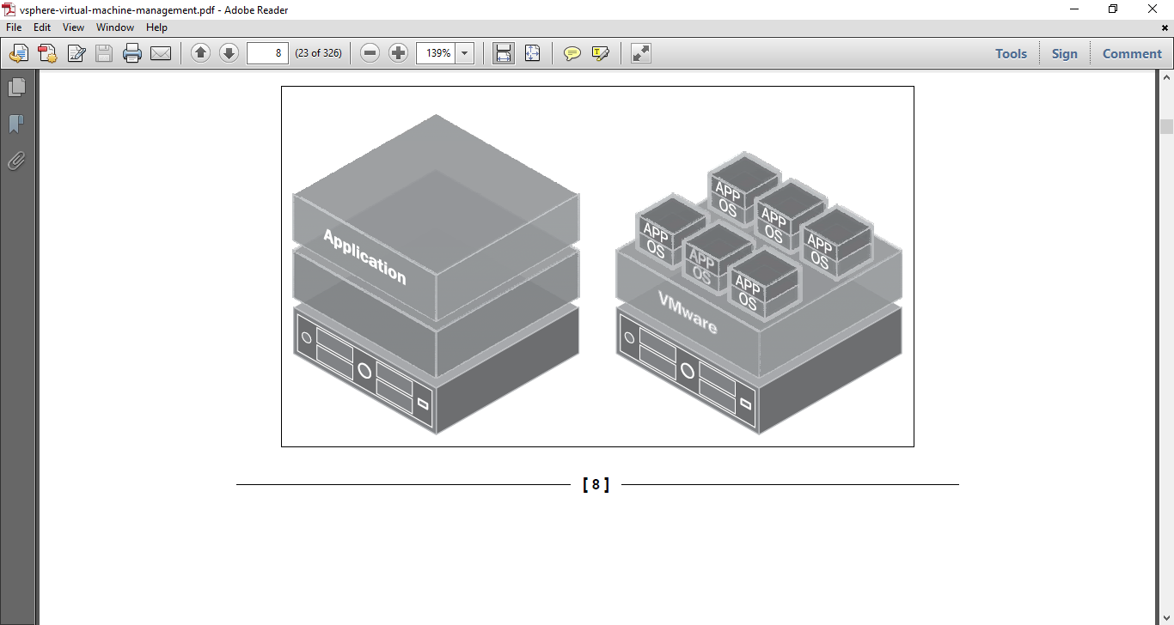
Virtual Machine Concepts Cont’d
The preceding diagram demonstrates the differences between the traditional physical architecture (left) and a virtual architecture (right). Notice that the physical architecture typically has a single application and a single operating system using the physical resources. The virtual architecture has multiple virtual machines running on a single physical server, accessing the hardware through the thin hypervisor layer.

Slide 9
Virtual machine components
When a virtual machine is created, a default set of virtual hardware is assigned to it. VMware provides devices and resources that can be added and configured to the virtual machine. Not all virtual hardware devices will be available to every single virtual machine; both the physical hardware of the ESXi host and the VM's guest OS must support these configurations. For example, a virtual machine will not be capable of being configured with more vCPUs than the ESXi host has logical CPU cores.

Slide 10
Virtual machine components cont’d
The options and configurations for these devices will be explained further during the last outline, Creating a Virtual Machine Using the Wizard. For example, we'll explore the effects of assigning virtual sockets versus that of assigning virtual cores on the virtual machine's vCPU.
The virtual hardware available includes:
BIOS: Phoenix Technologies 6.00 that functions like a physical server BIOS. Virtual machine administrators are able to enable/disable I/O devices, configure boot order, and so on.

Slide 11
Virtual machine components cont’d
DVD/CD-ROM: NEC VMware IDE CDR10 that is installed by default in new virtual machines created in vSphere. The DVD/CD-ROM can be configured to connect to the client workstation DVD/CD-ROM, an ESXi host DVD/CD-ROM, or even an .iso file located on a datastore. DVD/CD-ROM devices can be added to or removed from a virtual machine.
Floppy drive: This is installed by default with new virtual machines created in vSphere. The floppy drive can be configured to connect to the client device's floppy drive, a floppy device located on the ESXi host, or even a floppy image (.flp) located on a datastore. Floppy devices can be added to or removed from a virtual machine.
Hard disk: This stores the guest operating system, program files, and any other data associated with a virtual machine. The virtual disk is a large file, or potentially a set of files, that can be easily copied, moved, and backed up.

Slide 12
Virtual machine components cont’d
IDE controller: Intel 82371 AB/EB PCI Bus Master IDE Controller that presents two Integrated Drive Electronics (IDE) interfaces to the virtual machine by default. This IDE controller is a standard way for storage devices, such as floppy drives and CD-ROM drives, to connect to the virtual machine.
Keyboard: This mirrors the keyboard that is first connected to the virtual machine console upon initial console connection.
Memory: This is the virtual memory size configured for the virtual machine that determines the guest operating system's memory size.

Slide 13
Virtual machine components cont’d
Motherboard/Chipset: The motherboard uses VMware proprietary devices that are based on the following chips:
Intel 440BX AGPset 82443BX Host Bridge/Controller
Intel 82093 AA I/O Advanced Programmable Interrupt Controller
Intel 82371 AB (PIIX4) PCI ISA IDE Xcelerator
National Semiconductor PC87338 ACPI 1.0 and PC98/99 Compliant Super I/O
Parallel port: This is an interface for connecting peripherals to the virtual machine. Virtual parallel ports can be added to or removed from the virtual machine.

Slide 14
Virtual machine components cont’d
Network adapter: ESXi networking features provide communication between virtual machines residing on the same ESXi host, between VMs residing on different ESXi hosts, and between VMs and physical machines. When configuring a VM, network adapters (NICs) can be added and the adapter type can be specified.
PCI controller: This is a bus located on the virtual machine motherboard, communicating with components such as a hard disk. A single PCI controller is presented to the virtual machine. This cannot be configured or removed.
PCI device: DirectPath devices can be added to a virtual machine. The devices must be reserved for PCI pass-through on the ESXi host that the virtual machine runs on. Keep in mind that snapshots are not supported with DirectPath I/O pass-through device configuration. For more information on virtual machine snapshots, see http://vmware.com/kb/1015180.

Slide 15
Virtual machine components cont’d
Pointing device: This mirrors the pointing device that is first connected to the virtual machine console upon initial console connection.
Processor: This specifies the number of sockets and core for the virtual processor. This will appear as AMD or Intel to the virtual machine guest operating system depending upon the physical hardware.
Serial port: This is an interface for connecting peripherals to the virtual machine. The virtual machine can be configured to connect to a physical serial port, a file on the host, or over the network. The serial port can also be used to establish a direct connection between two VMs. Virtual serial ports can be added to or removed from the virtual machine.

Slide 16
Virtual machine components cont’d
SCSI controller: This provides access to virtual disks. The virtual SCSI controller may appear as one of several different types of controllers to a virtual machine, depending on the guest operating system of the VM. Editing the VM configuration can modify the SCSI controller type, a SCSI controller can be added, and a virtual controller can be configured to allocate bus sharing.
SCSI device: A SCSI device interface is available to the virtual machine by default. This interface is a typical way to connect storage devices (hard drives, floppy drives, CD-ROMs, and so on) to a VM. SCSI device that can be added to or removed from a virtual machine.
SIO controller: The Super I/O controller provides serial and parallel ports, and floppy devices, and performs system management activities. A single SIO controller is presented to the virtual machine.

Slide 17
Virtual machine components cont’d
USB controller: This provides USB functionality to the USB ports managed. The virtual USB controller is a software virtualization of the USB host controller function in a VM.
USB device: Multiple USB devices may be added to a virtual machine. These can be mass storage devices or security dongles. The USB devices can be connected to a client workstation or to an ESXi host.
Video controller: This is a VMware Standard VGA II Graphics Adapter with 128 MB video memory.
VMCI: The Virtual Machine Communication Interface provides high-speed communication between the hypervisor and a virtual machine. VMCI can also be enabled for communication between VMs. VMCI devices cannot be added or removed.

Slide 18
Uses of virtual machines
In any infrastructure, there are many business processes that have applications supporting them. These applications typically have certain requirements, such as security or performance requirements, which may limit the application to being the only thing installed on a given machine. Without virtualization, there is typically a 1:1:1 ratio for server hardware to an operating system to a single application. This type of architecture is not flexible and is inefficient due to many applications using only a small percentage of the physical resources dedicated to it, effectively leaving the physical servers vastly underutilized. As hardware continues to get better and better, the gap between the abundant resources and the often small application requirements widens. Also, consider the overhead needed to support the entire infrastructure, such as power, cooling, cabling, manpower, and provisioning time. A large server sprawl will cost more money for space and power to keep these systems housed and cooled.

Slide 19
Uses of virtual machines cont’d
In the end, virtualizing the infrastructure and using virtual machines will help save time, space, and money. However, keep in mind that there are some upfront costs to be aware of. Server hardware may need to be upgraded or new hardware purchased to ensure compliance with the VMware Hardware Compatibility List (HCL). Another cost that should be taken into account is the licensing costs for VMware and the guest operating system; each tier of licensing allows for more features but drives up the price to license all of the server hardware.

Slide 20
primary virtual machine resources
Virtualization decouples physical hardware from an operating system. Each virtual machine contains a set of its own virtual hardware and there are four primary resources that a virtual machine needs in order to correctly function. These are CPU, memory, network, and hard disk. These four resources look like physical hardware to the guest operating systems and applications. The virtual machine is granted access to a portion of the resources at creation and can be reconfigured at any time thereafter. If a virtual machine experiences constraint, one of the four primary resources is generally where a bottleneck will occur.

Slide 21
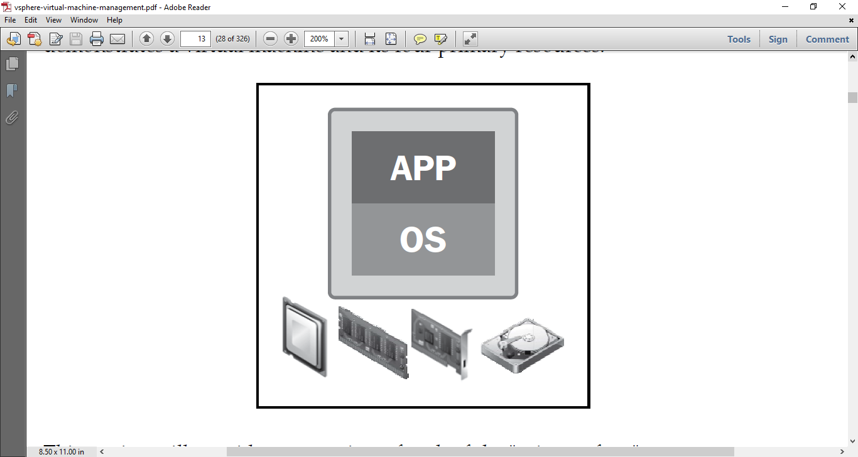
primary virtual machine resources cont’d
In a virtualized environment, a virtual machine interacts with the physical hardware through a thin layer of software known as the virtualization layer or the hypervisor; in this case the hypervisor is ESXi. This hypervisor allows the VM to function with a degree of independence from underlying physical hardware. This independence is what allows vMotion and Storage vMotion functionality. The following diagram demonstrates a virtual machine and its four primary resources:

Slide 22
primary virtual machine resources cont’d
This section will provide an overview of each of the "primary four" resources. Configurations for these resources will be discussed in during the last outline, Creating a Virtual Machine Using the Wizard.

Slide 23
primary virtual machine resources cont’d
CPU
The virtualization layer runs CPU instructions to make sure that the virtual machines run as though accessing the physical processor on the ESXi host. Performance is paramount for CPU virtualization, and therefore will use the ESXi host physical resources whenever possible. The following image displays a representation of a virtual machine's CPU:
A virtual machine can be configured with up to 64 virtual CPUs (vCPUs) as of vSphere 5.5. The maximum vCPUs able to be allocated depends on the underlying logical cores that the physical hardware has. Another factor in the maximum vCPUs is the tier of vSphere licensing; only Enterprise Plus licensing allows for 64 vCPUs.

Slide 24
primary virtual machine resources cont’d
Memory
In a physical architecture, an operating system assumes that it owns all physical memory in the server, which is a correct assumption. A guest operating system in a virtual architecture also makes this assumption but it does not, in fact, own all of the physical memory. A guest operating system in a virtual machine uses a contiguous virtual address space that is created by ESXi as its configured memory. The following image displays a representation of a virtual machine's memory:
Virtual memory is a well-known technique that creates this contiguous virtual address space, allowing the hardware and operating system to handle the address translation between the physical and virtual address spaces. Since each virtual machine has its own contiguous virtual address space, this allows ESXi to run more than one virtual machine at the same time. The virtual machine's memory is protected against access from other virtual machines.

Slide 25
primary virtual machine resources cont’d
Network
There are two key components with virtual networking: the virtual switch and virtual Ethernet adapters. A virtual machine can be configured with up to ten virtual Ethernet adapters, called vNICs. The following image displays a representation of a virtual machine's vNIC:
Virtual networks operate on layer 2, data link, of the OSI model. A virtual switch is similar to a physical Ethernet switch in many ways. For example, virtual switches support the standard VLAN (802.1Q) implementation and have a forwarding table, like a physical switch. An ESXi host may contain more than one virtual switch. Each virtual switch is capable of binding multiple vmNICs together in a network interface card (NIC) team, which offers greater availability to the virtual machines using the virtual switch.

Slide 26
primary virtual machine resources cont’d
Disk
In a non-virtualized environment, physical servers connect directly to storage, either to an external storage array or to their internal hard disk arrays to the server chassis. The issue with this configuration is that a single server expects total ownership of the physical device, tying an entire disk drive to one server. Sharing storage resources in non-virtualized environments can require complex filesystems and migration to file-based Network Attached Storage (NAS) or Storage Area Networks (SAN). The following image displays a representation of a virtual disk:
Shared storage is a foundational technology that allows many things to happen in a virtual environment (High Availability, Distributed Resource Scheduler, and so on). Virtual machines are encapsulated in a set of discrete files stored on a datastore. This encapsulation makes the VMs portable and easy to be cloned or backed up. For each virtual machine, there is a directory on the datastore that contains all of the VM's files. A datastore is a generic term for a container that holds files as well as .iso images and floppy images. It can be formatted with VMware's Virtual Machine File System (VMFS) or can use NFS. Both datastore types can be accessed across multiple ESXi hosts.

Slide 27
Virtual machine files
vSphere administrators should know the components of virtual machines. There are multiple VMware file types that are associated with and make up a virtual machine. These files are located in the VM's directory on a datastore. The following table will summarize and provide a quick reference and short description of the files that make up a virtual machine.
Depending on the state and configuration of the virtual machine, not all files may be present in the virtual machine directory.

Slide 28
Virtual machine files
File | Example filename | Description
.vmx | <vmname>.vmx | Configuration file
.vmfx | <vmname>.vmfx | Additional configuration file
.vmtx | <vmname>.vmtx | Template file
.nvram | <vmname>.nvram | BIOS/EFI configuration
.vawp | <vmname>.vswp vmx-<vmname>.vswp | Swap files
.log | vmware.log, vmware-##.log | Current log file Old log file entries
vmdk | <vmname>.vmdk | Virtual disk descriptor
-flat.vmdk | <vmname>-flat.vmdk | Data disk
-rdm.vmdk | <vmname>-rdm.vmdk | Raw device map file
-delta.vmdk | <vmname>-delta.vmdk | Snapshot disk
.vmsd | <vmname>.vmsd | Snapshot description data
.vmsn | <vmname>.vmsn | Snapshot state
.vmss | <vmname>.vmss | Suspend file

Slide 29
VMware Tools
VMware Tools is a utility suite that enhances the performance of a virtual machine's guest OS. If VMware Tools is not installed in the guest operating system, the guest will be lacking in some important functionality. The VMware Tools utility improves virtual machine management by replacing the generic OS drivers with VMware drivers optimized for virtual hardware. The following components are included after the installation of VMware Tools:
The VMware Tools service
VMware Tools device drivers
The VMware user process
VIX

Slide 30
VMware Tools cont’d
The VMware Tools service passes information between guest operating systems and the ESXi host; service starts when the guest OS boots. This runs as a vmtoolsd.exe program in Windows, vmware-tools-daemon in Mac OS X, and vmtoolsd in Solaris, FreeBSD, and Linux guest operating systems.
This service can run scripts that help automate repetitive guest operating system operations. Synchronization of the guest operating system time with the time on the ESXi host (with the exception of Mac OS X) can be configured with VMware Tools, though this is not necessarily recommended. Another benefit is the ability to move the mouse cursor freely between a Windows guest operating system in the VM and the vSphere Client (otherwise, Ctrl + Alt must be pressed in order to release the cursor from the VM console). Windows operating systems have the ability to quiesce snapshots used by certain backup operations provided by the service. VMware Tools also provides the process that sends heartbeats to VMware products to indicate that the guest operating system is running.

Slide 31
VMware Tools cont’d
VMware Tools device drivers refine mouse operations and improve performance of networking, sound, and graphics. The guest OS will determine which drivers are installed with VMware Tools. The following device drivers can be included with VMware Tools:
Driver | Description
SVGA driver | Replaces the default VGA driver (640 x 480 resolution and 16-color graphics), enabling 32-bit displays, high display resolution, and faster graphics performance. Windows OSes that are Vista or later will use the VMware SVGA 3D driver.
SCSI driver | The VMware Paravirtual SCSI driver is included with VMware Tools for use. Other storage adapter drivers are bundled with the OS or are available via third-party vendors.
Paravirtual SCSI driver | High performance storage adapter that can produce greater throughput and lower processor utilization. This is best suited for a VM with an application that produces a very high amount of I/O throughput.

Slide 32
VMware Tools cont’d
Driver | Description
VMXNET NIC drivers | When installed, the VMXNET family of adapters can replace the default emulated networking drivers. These paravirtualized VMXNET adapters improve network performance and increase features.
Mouse driver Audio driver | Improves mouse performance. Required for many Windows OSes.
Memory control driver | Used for efficient memory allocation between virtual machines, commonly called the balloon driver.
vShield Endpoint | When using vShield, a custom VMware Tools installation can install the vShield Endpoint Thin Agent component. vShield Endpoint offloads antivirus scans to the hypervisor without a large agent.
ThinPrint driver | Enables virtual printing for Windows VMs; printers will be listed in the guest OS that are added to the OS on the client or host.

Slide 33
VMware Tools cont’d
Driver | Description
Modules and drivers for support of automatic virtual machine backups | Allows for third-party, vSphere integrated backup software to create application consistent snapshots. The virtual machine's disks are quiesced and certain processes are paused during the snapshot process. The Volume Shadow Copy Services (VSS) for Windows Server 2003 or newer, and the Filesystem Sync driver for older Windows OSes are installed.
VMCI and VMCI Sockets drivers | The Virtual Machine Communication Interface driver allows for efficient and fast communication between VMs on the same ESXi host.

Slide 34
VMware Tools cont’d
The VMware user process starts when a user logs in to a Windows guest OS or starts a desktop environment session in Linux. The process' program file is called vmtoolsd.exe on Windows guest OSes and vmusr for FreeBSD, Solaris, and Linux operating systems. This allows for copy-and-paste interaction between the guest operating system and the vSphere Client, matching the screen display resolution of the guest with that of the vSphere Client.
VIX support is provided for using the VMware VIX API for guest operating system-bound API calls. The VIX API allows for the automation of virtual machine operations on the ESXi platform.

Slide 35
PRACTICAL ON Creating a Virtual Machine Using the Wizard

Slide 36
Summary
As an administrator, you needs to understand virtual machine concepts before creating virtual machines. A virtual machine is a set of virtual hardware presented to a guest operating system whose characteristics are determined by a set of files. There are multiple VMware file types that are associated with and make up a virtual machine and are located in the VM's directory on a datastore. These files include the .vmx, .nvram, .vswp, .vmdk, -flat.vmdk, and .log files. Each virtual machine is equipped with virtual hardware and devices, such as one or more virtual CPUs, memory, video cards, IDE devices, SCSI devices, DVD/CD-ROM, parallel and serial ports, and network adapters, that provide the same functionality as physical hardware. Once the administrator understands that the virtual hardware is available, the next step is to learn how it can be configured. VMware Tools is a utility suite that enhances the performance of a virtual machine's guest OS. VMware Tools should be installed in every virtual machine to ensure the virtual machines aren't lacking in any functionality.

